Slide 1
Why build Progressive Web Apps?

Slide 2


Notes:
Let's take it back — right back — to the 1820s!
This is Babbage's Difference Engine.
Designed to tabulate polynomial functions, such logarithms. One machine, one app, hand built, hard coded.
To get a new app you had to get Babbage to design a new machine ‚— and wait nearly 200 years for someone to build it!

Slide 3
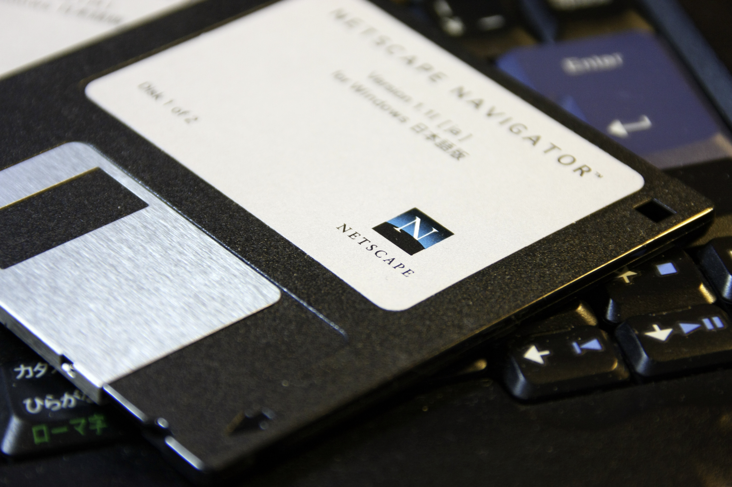
flickr.com/photos/oimax
Notes:
Move forward 150 years — and software looked like this. Big programs needed 10 or more disks.
CDs and then DVDs were a revolution.
MapPoint could be bought from the book store! This had pan & zoom! It completely changed trip planning.
Web-based maps at the time couldn't do anything like that.

Slide 4

Notes:
Let's move forward a few years….
Google Maps happened; pan & zoom!
Worked on any computer, not just one you spent 30 minutes installing on
When capable, the web's distribution model wins.
Raise your hand if you use Google Maps on the web on desktop.
Thought so.
What about on mobile? Who goes to a browser to get to maps on phone?

Slide 5
The hardest problem with software is distribution
Notes:
Anyone who's ever worked in IT will understand this!
The hardest problem with software is distribution
So how does this play out on mobile?

Slide 6
.vs.
13%
87%
Mobile web
Apps
Source: comScore Mobile Metrix, U.S., Age 18+, June 2015
Notes:
It's true that users are spending most of their time in native apps.
Re-engagement features keep users in native apps, Push brings users back even when the app is closed, and homescreen icons maintain visibility.

Slide 7
80%
OF TIME SPENT IS IN
USERS’ TOP 3 APPS
Source: comScore Mobile Metrix, U.S., Age 18+, June 2015
Notes:
But usage is highly concentrated — it's a winner-take-all situation.
App developers often spend more for distribution than they earn back.
So, if the native ecosystem isn't going so well, why hasn't web been more disruptive?

Slide 8
Capability
Web
Notes:
Here's one way to think of the differences between Web and native: the capability axis.
Native apps have the ability to start up fast and reliably. They can work offline, and use push, sync and sensors.
The Web is safer, more respectful of privacy, but doesn't have those native features.

Slide 9
App
*
Capability
Web
Web
Reach
Notes:
If we add another axis, reach, can see where the Web succeeds.
According to a recent comScore study, the average user installs zero apps per month!
Google data shows that mobile users visit around 100 sites per month.
This is the power of URLs: they meet one-off needs.

Slide 10
App
PWA
Capability
Web
Web
Reach
Notes:
What if web could meet those UX expectations?
This is what Progressive Web Apps represent. PWA for short.
Web apps are finally able to earn their place on homescreen and in the notification tray.
...and they don't have to give up reach.

Slide 11
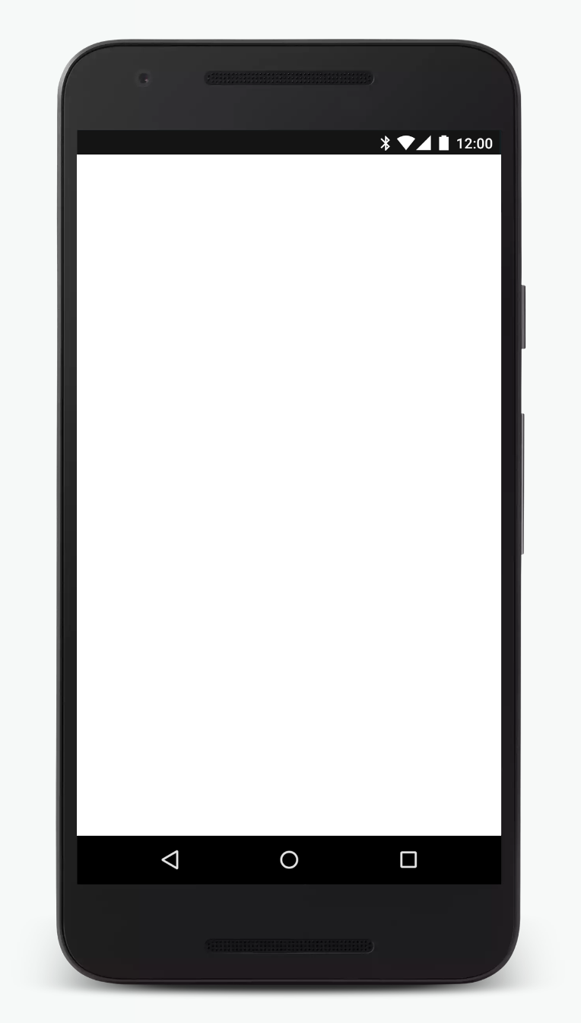
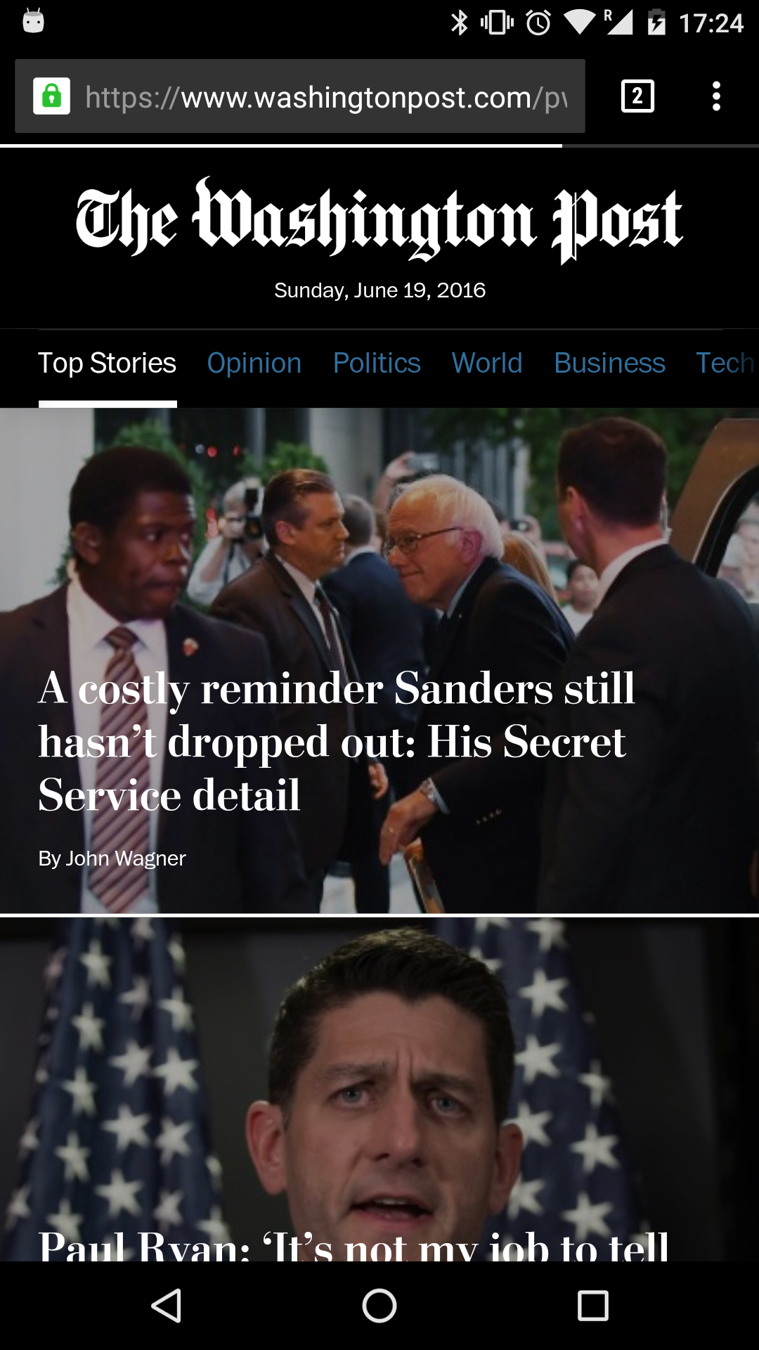
Notes:
What do those these PWA experiences look like?
Here's wapo.com/pwa.
Loads in a tab like any other site.

Slide 12
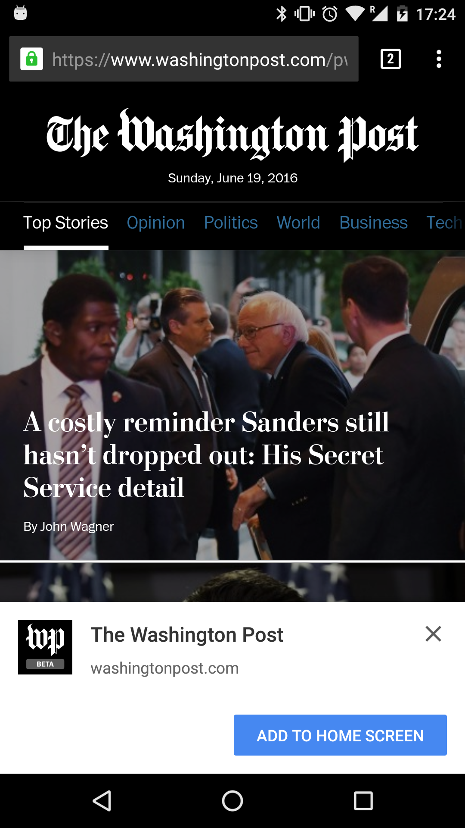
Notes:
If you use it a few times, the add to homescreen prompt is shown.
If you tap it...

Slide 13
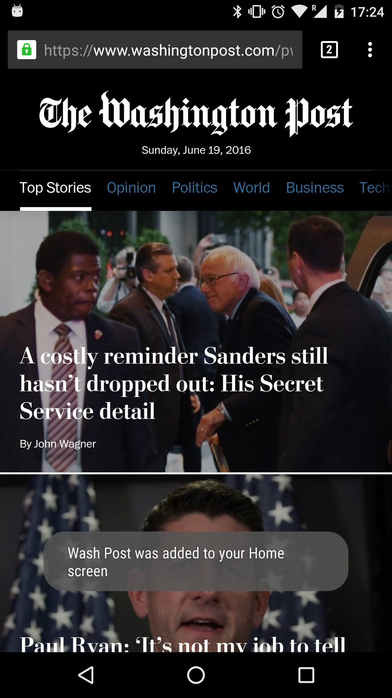
Notes:
...browser lets you know it's added

Slide 14
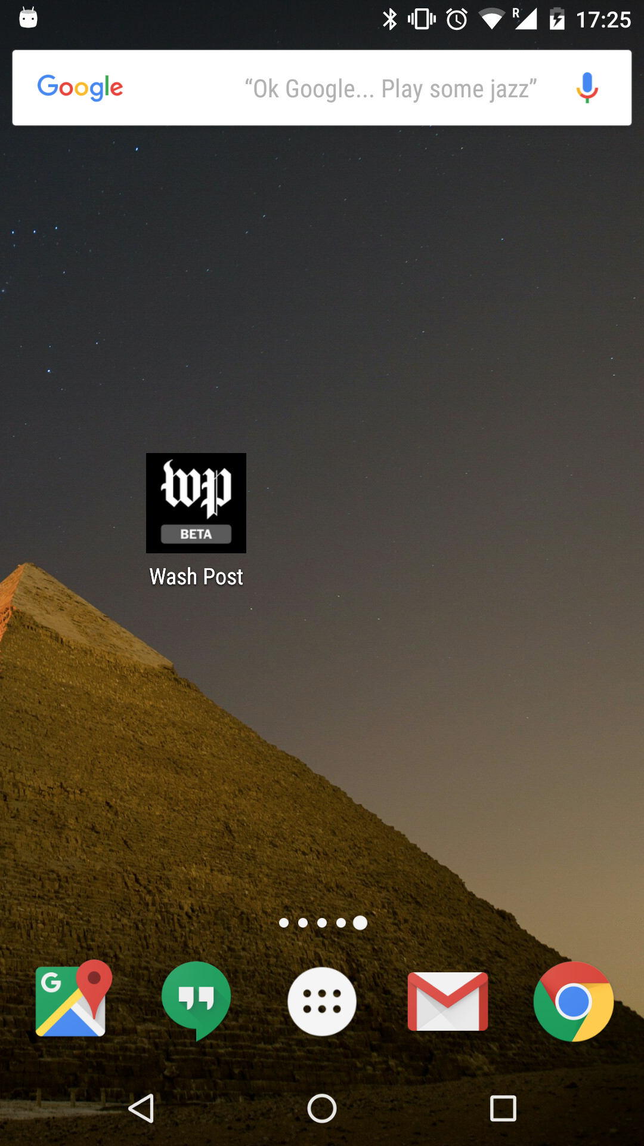
Notes:
The icon is now available from the homescreen.
If tap it...

Slide 15
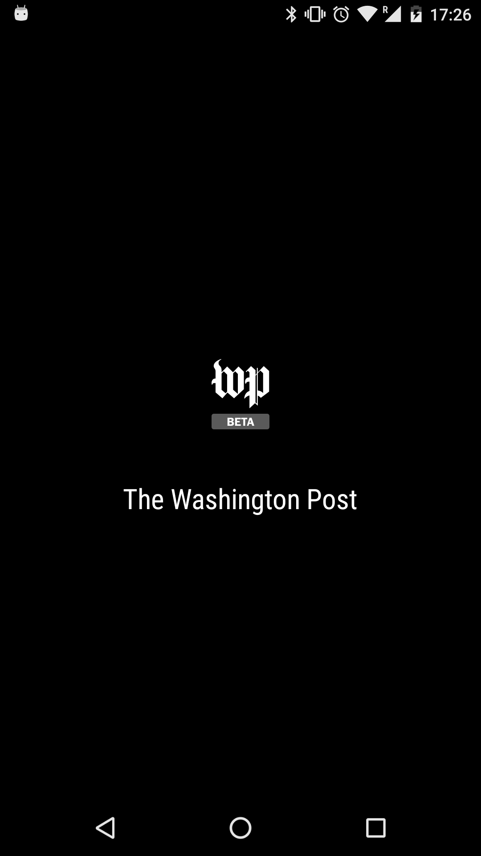
Notes:
...the app starts with a splashscreen...

Slide 16
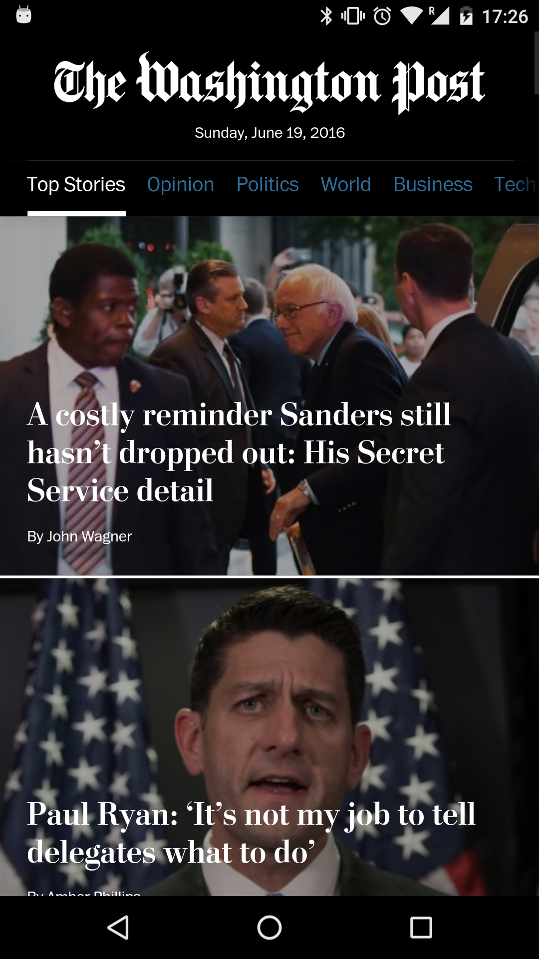
Notes:
...and runs full-screen.
Tap to get to the task switcher...

Slide 17
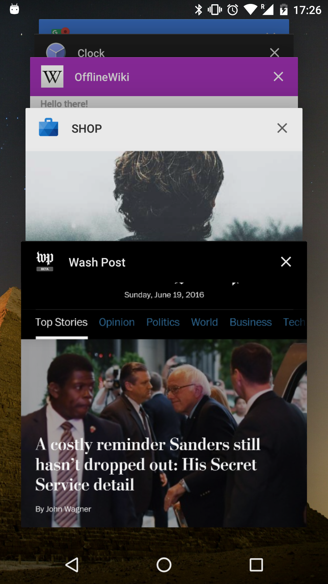
Notes:
...and there's the Progressive Web App alongside other native apps.

Slide 18
It's all about removing friction
Notes:
What they've done is to make it incredibly easy for users to get at what they want.

Slide 19
What was missing?
Reliable performance
Push notifications
Homescreen icon metadata
Notes:
So what was missing from the Web?
First, we needed reliability and performance on par with native apps.
Next, we needed to be in notification tray.
Lastly, once trustworthy, we needed to be on the home screen.

Slide 20
What was missing?
Reliable performance
Push notifications
Homescreen icon metadata
Notes:
Let's talk about performance.

Slide 21
Faster is better
Source: SOASTA, 2015
58%
Sessions
Bounce rate
bounce
180,000
rate
58
140,000
45
100,000
32
Sessions
Bounce rate (%)
60,000
19
20,000
20%
6
13%
bounce
rate
0
bounce
0
rate
2.4
2.7
3.0
3.3
3.6
3.9
4.2
4.5
4.8
5.1
5.4
5.7
6.0
6.3
6.6
6.9
7.2
7.5
7.8
8.1
8.4
8.7
9.0
9.3
9.6
9.9
Load time (in seconds)
Notes:
We all know time is money.
This data shows just how badly bounce rate increases with load time.

Slide 22

40%
of users bounce from sites that take longer than 3 seconds to load
Notes:
Other studies show that after just three seconds, 40% of users will abandon a website.
40%!

Slide 23
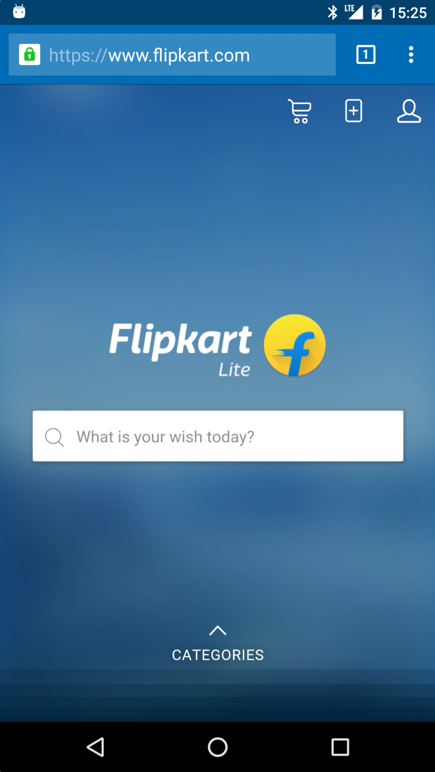

Service workers enable reliable performance
Service worker
Client side proxy written in JavaScript
Web server
Cache
Notes:
But what if you didn't need to traverse the network every time for every asset? What if you could intelligently cache assets locally, reliably?
That's what Service Workers do.
Service Workers enable you to implement caching with the Cache API, not just by hoping to rely on browser caching.
This means that after the first visit, sites and apps can be reliably fast.

Slide 24
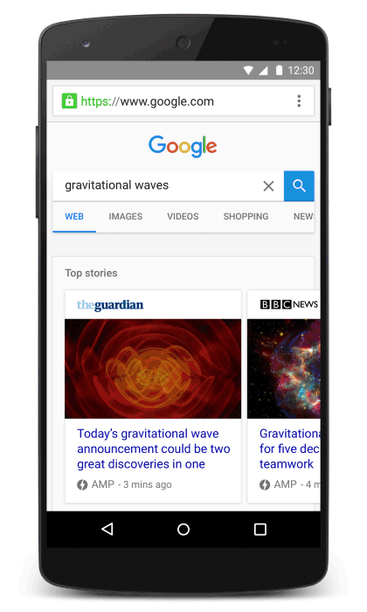
<1 second
median load time
4x
10x
faster
less data
Notes:
That's huge, but what about the first visit?
The AMP project from the Google Search team to address web obesity epidemic.
AMP provides reliably-fast web components for first load.
These AMP components are much faster to load and less data hungry than non-AMP content.

Slide 25
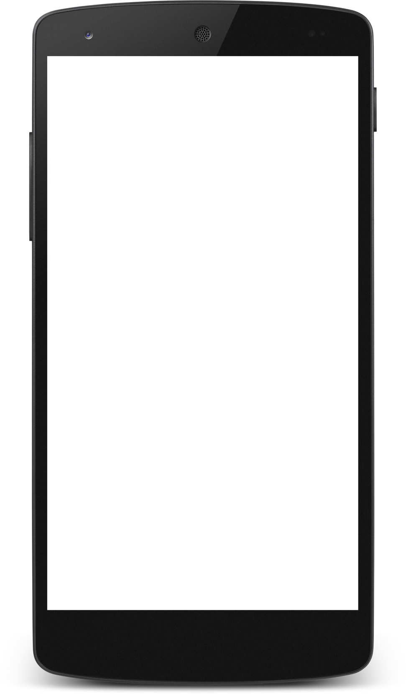
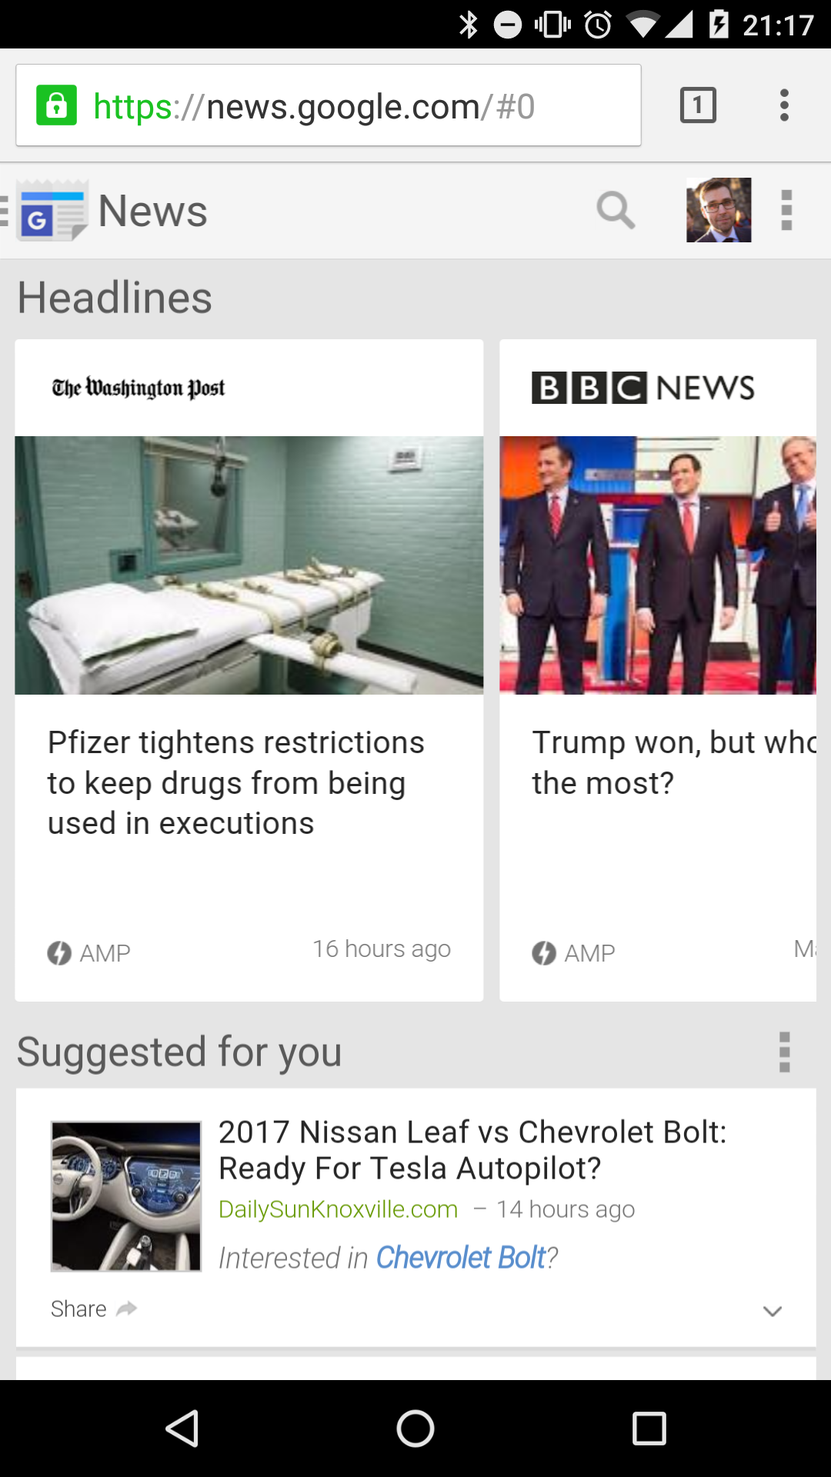
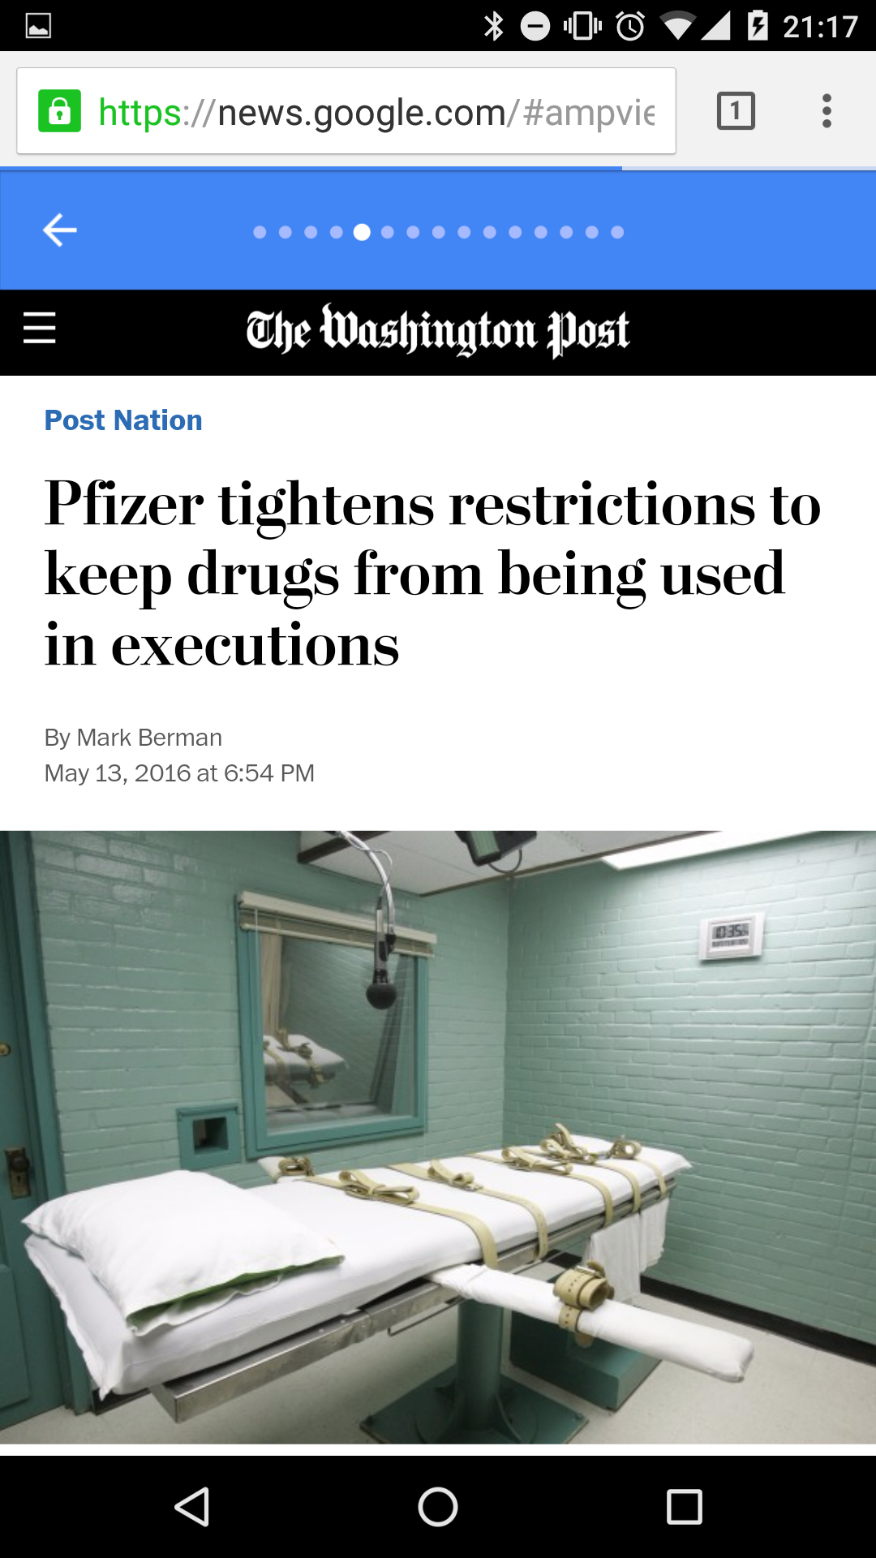

<amp-install-serviceworker>
Notes:
What if could combine the two?
Fast-first-load with reliable performance subsequently?
We can do that by combining AMP and Service Worker. This is where AMP meets PWA!
Here's an example.
News stories on the Washington Post are super fast to load because they use AMP.
Once a story page is loaded, the site installs a Service Worker, and assets are cached intelligently.
That provides reliable speed that native can't touch.

Slide 26
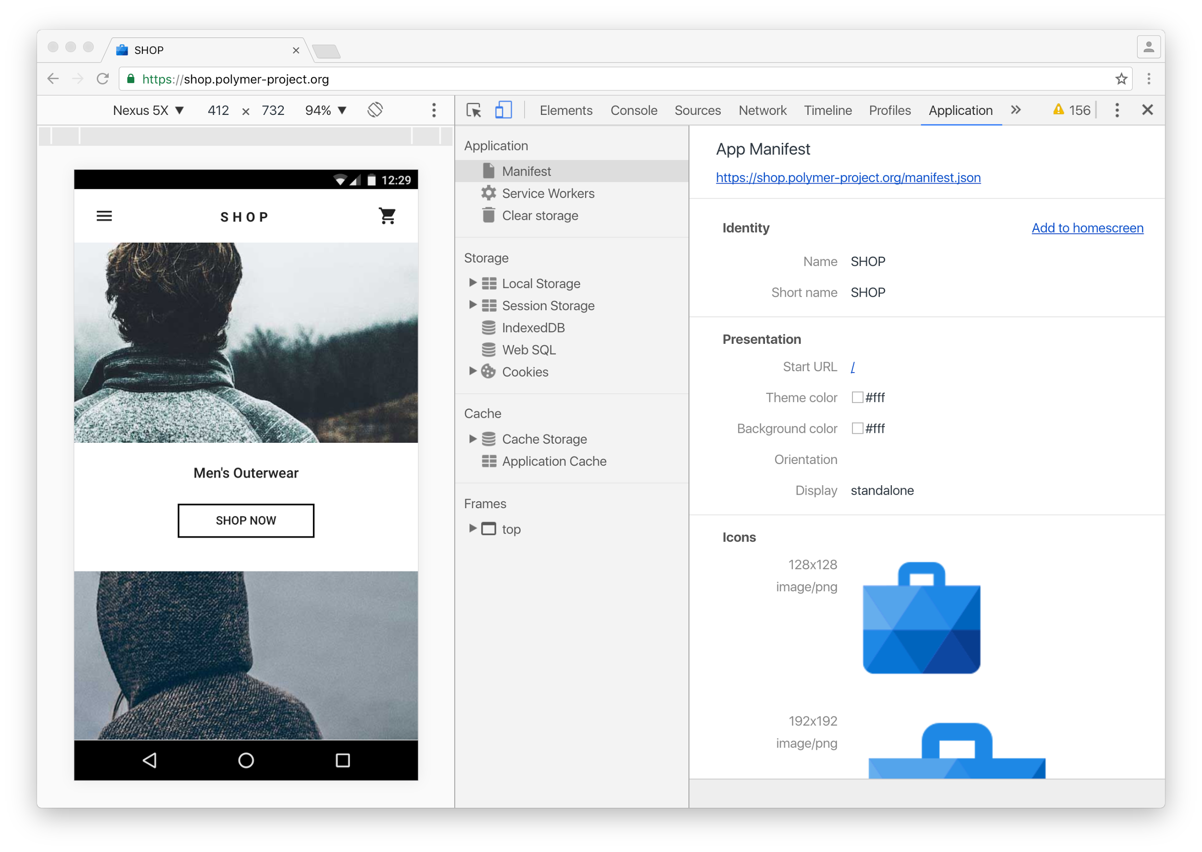
Notes:
Want to try out Progressive Web Apps?
There are great tools built into the Chrome DevTools.

Slide 27
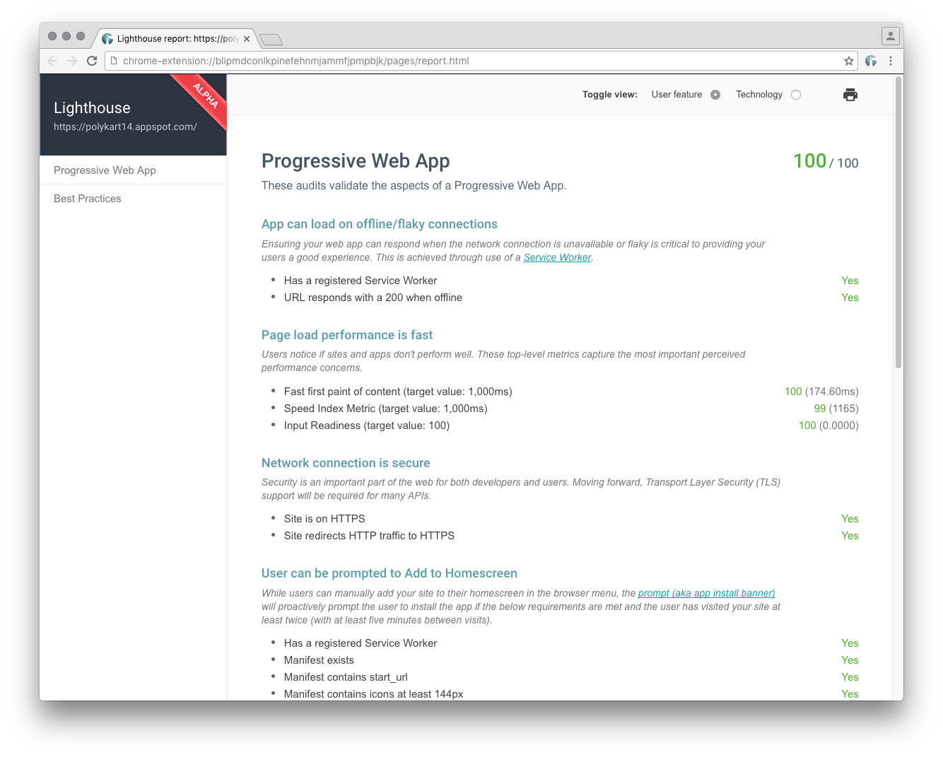
github.com/GoogleChrome/lighthouse
Notes:
For PWA developers, Google engineers have also created Lighthouse.
This gives you an extension that reports on how your PWA is doing, as well as command line tools you can build into your workflow and production processes.

Slide 28
Web Payments API
Credential Management API
Notes:
There are loads of other new capabilities coming to the Web. Too many to talk about here!
Web Assembly and WebGL to unlock games, Media capture + stream encoding for user generated content — and many more.
But two particular APIs that are shipping this year will change many kinds of apps.
Web Payments and Credential Management.

Slide 29
Web Payments API
Credential Management API
Notes:
The first is Web Payments.
This is a standards-based way to enable easy checkout on the Web.

Slide 30
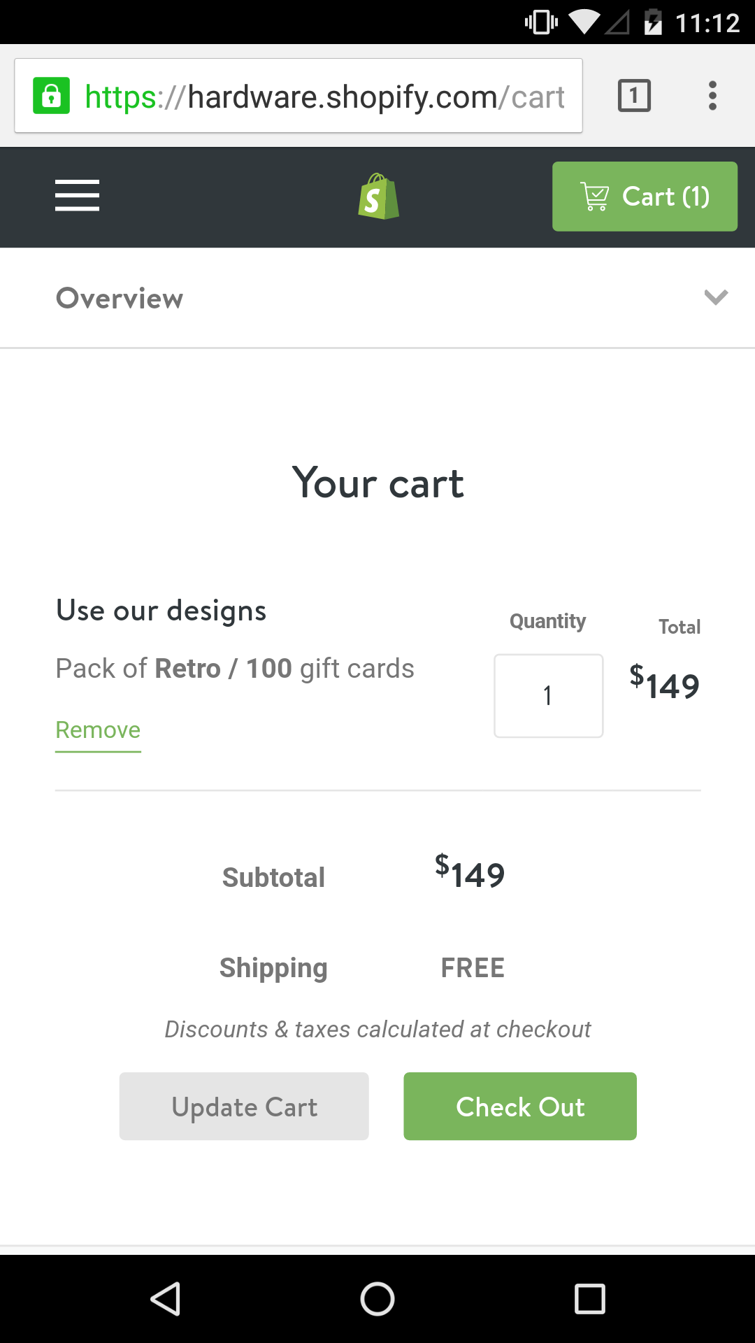
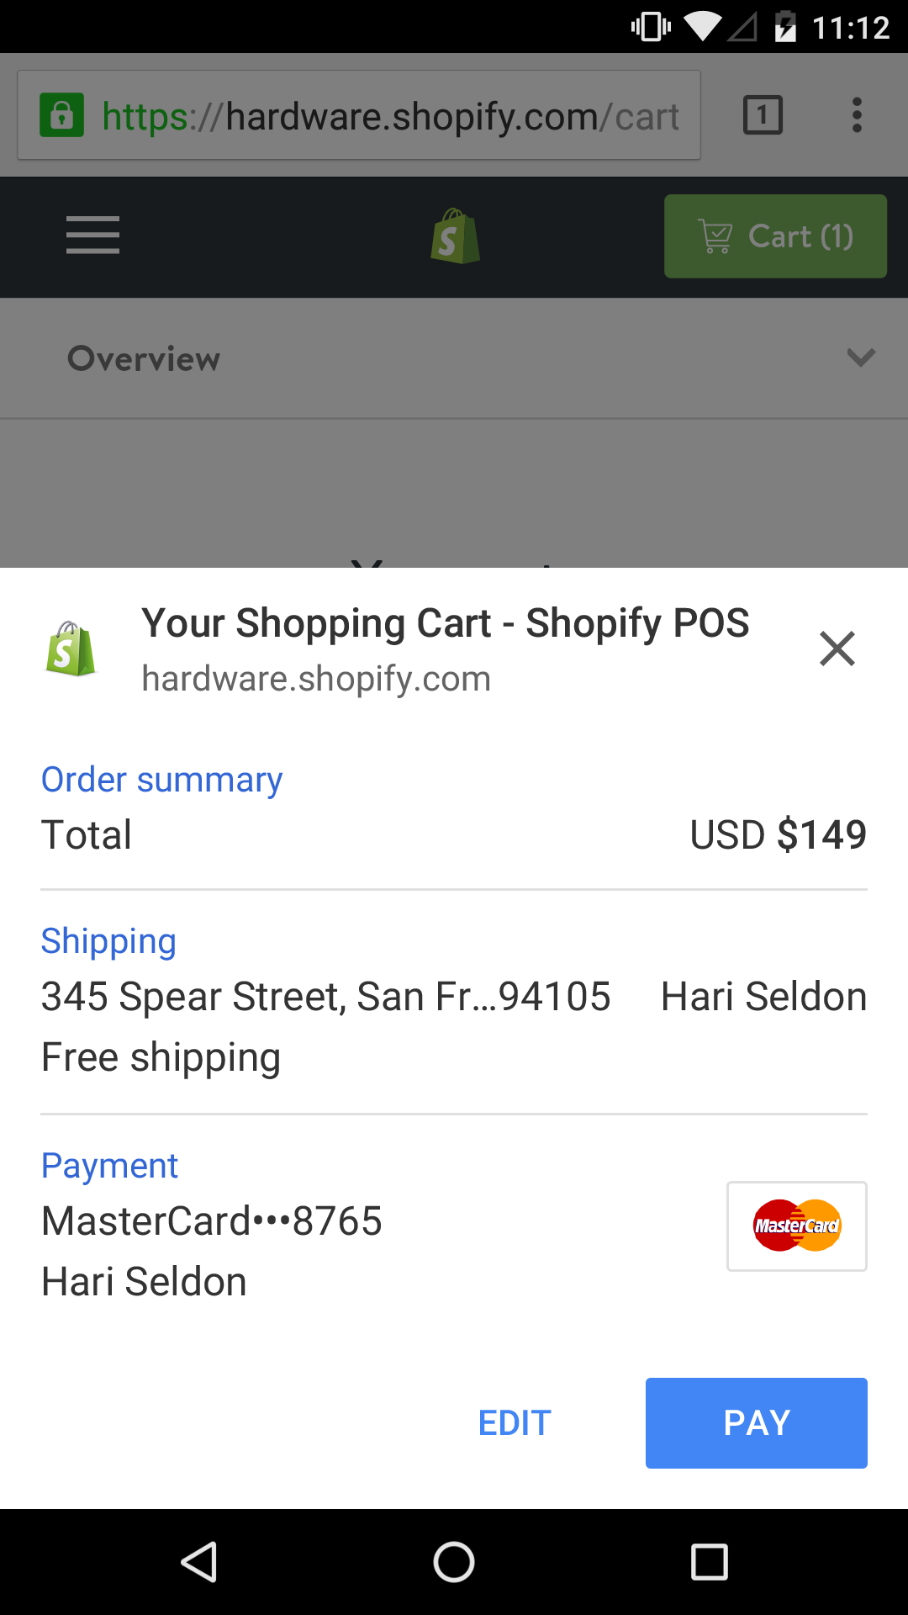
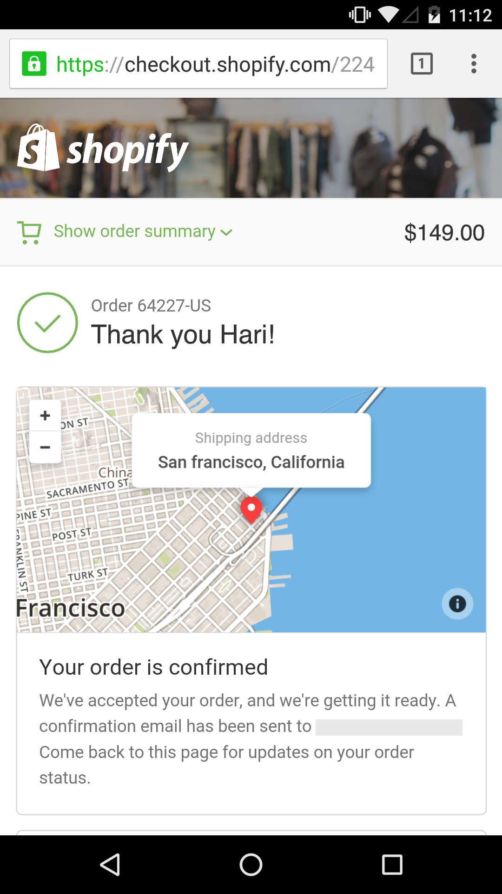
One tap check out with Shopify
Notes:
Web checkout using fiddly forms is a pain!
Mobile makes this even harder — entering data via on-screen keyboards is difficult and insecure.
The Web Payments API reduce this to a prompt…
...a confirmation…
And done!

Slide 31

Notes:
If Android Pay supported by site and phone, can be even easier.

Slide 32
Web Payments API
Credential Management API
Notes:
Another transformative API is the Credential Management API.
This simplifies the whole process of managing identity on the Web, and enables one-touch login.

Slide 33

One-tap sign in
Notes:
Here's kayak.com using Credenttial Management sync'd via Smart Lock with a single tap.

Slide 34
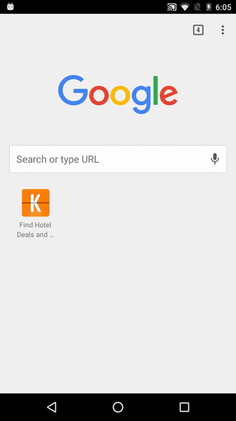
Auto sign in
Notes:
On sites that support it, the Credential Management API also allows automatic sign-in for users that previously visited.

Slide 35
Progressive Web Apps
Reliable: Fast loading, work offline and on flaky networks
Fast: Smooth animation, jank-free scrolling and seamless navigation
Engaging: Launched from the home screen and send push notifications
Notes:
To sum up: PWAs are reliable, fast and engaging.

Slide 36
Why is this important?
How do we get started?
Notes:
The feedback we get from talking to many developers in many regions boils down to two key questions…
Why is this important?
How do we get started?

Slide 37
Why is this important?
How do we get started?
Notes:
For why it’s important, let's look at the overall market.
Here, we’ll focus on some high level metrics: reach, acquisition and conversion.

Slide 38
Reach
Notes:
Let’s talk about reach and how we’re seeing overall mobile web audience grow

Slide 39
1B
monthly mobile
Chrome users
Notes:
We have data for Chrome: 1B monthly users on mobile.
This was just 400M last year, and Chrome is only four years old!
On average, Chrome on Android users visit 100 sites per month.
Let’s drill down to site level data.

Slide 40
Reach on mobile web 2.5x of apps
Apps
Mobile web
8.9
3.3
Monthly unique visitors (MM)
Source: comScore Mobile Metrix, U.S., Age 18+, June 2015. Top 1000 sites vs. Top 1000 apps
Notes:
This Comscore data compares reach of the top 1000 sites and apps. Here, you see that mobile web reach is 2.5x that of apps. So when you are able to deliver a better experience to a wider audience, this makes a compelling case.
And you’re likely seeing similar numbers on your own site. It’s worth gut checking your own site traffic numbers and understanding the traffic breakdown between app and mobile web. Anecdotally, we’ve heard sites say that mobile web traffic ranges from 50% to as high as 90% of mobile traffic.
So this data is great. We’re seeing growth in mobile web and that reach is more than double of app traffic. The next question: are there real businesses, at scale seeing success with these investments? We’ve been working hard to provide real life examples so that you have proof points.

Slide 41
Today’s mobile web
Broad Reach, Low Engagement
Top 1000 mobile apps .vs. top 1000 mobile web properties
Apps
8.9
Mobile web
201.8
3.3
10.9
Monthly UNIQUE visitors (MM)
Average minutes per visitor
comScore Mobile Metrix, U.S., Age 18+, June 2015
Notes:
Removing barriers to entry means that users are much more likely to try out a mobile web property than an app.
The mobile web sees many more unique users.
However, as you can see, native apps capture users’ attention. Native apps currently get a lot more user engagement.
Can we have both?

Slide 42
Acquisition
Notes:
Another data point to look at is how easily users are able to discover and experience your service.
Acquisition is about getting more users to your site, and that sometimes means paying for users.

Slide 43
Selio: user acquisition costs
€4.00
€0.35
Android App
Mobile Web
Notes:
Here's an example.
Selio is a local marketplace site for buying and selling goods.
They built a progressive web app and saw similar engagement numbers as their app.
However, they found that user acquisition cost could be up to 10 times cheaper for their web app compared to their native app.
The web has incredibly low friction and as a result, it’s also less expensive to acquire users.
I know, you must be thinking, that’s what the marketing team worries about. But hey, if you’re trying to build a business case, you have to think about these multiple forces at play.

Slide 44
Conversion
Notes:
Conversion is about getting a visitor to become a more frequent user of your site and in some cases getting a user to complete a transaction.

Slide 45
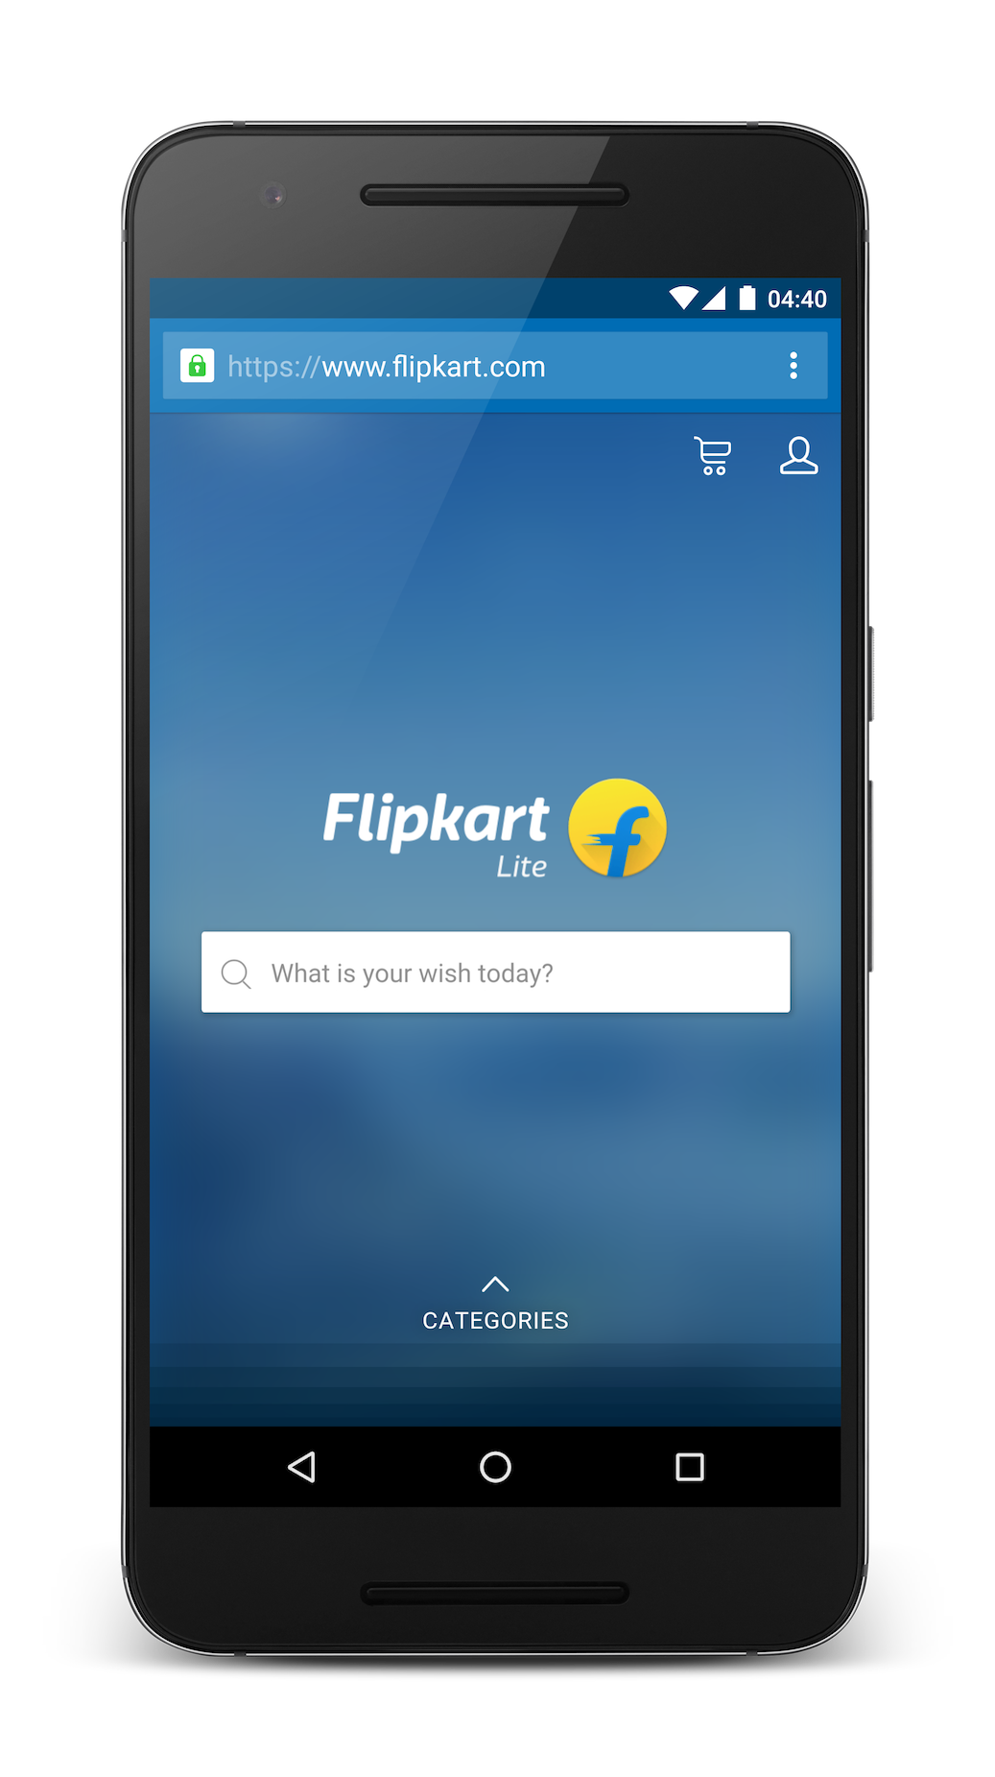



2x more
page views
74% increase
in time spent
82% more
conversions on iOS
Notes:
AliExpress, based in China, is one of the largest e-commerce players globally.
With their PWA they saw massive uplift within days.
They saw a 74% increase in time spent on the site and two times more pages visited.
For them the number that really matters is whether users actually convert, complete transactions.
AliExpress saw conversions go up across the board.
You might think that since many Progressive Web App features don't work on Safari that that this wouldn't help with users on iOS.
It turned out that wasn't the case at all.
Using the PWA approach to building for the Web, AliExpress saw an 82% increase in their conversion rate on iOS!
The Progressive in PWA does make sense, and focusing on the end-to-end user experience will still have a dramatic impact on your business, even with users who can't experience the full power of Progressive Web Apps.

Slide 46
"One of the reasons we built a Progressive Web App was to be able to invest in the web experience across all browsers. Not only did we see huge benefits on browsers that support the latest features, but we also got to see a bump across the board. That is the sign of a great investment, and one that will keep paying for itself as browsers evolve."
— Lijun Chen, Director of AliExpress Mobile Team.
Notes:
AliExpress already had a mobile website and they decided to supercharge it with PWA features and got terrific results
Here's a quote from the Director of Mobile at AliExpress emphasizing that investing in a great mobile web experience benefits all users, no matter what platform they're on.

Slide 47
Improve
conversion
Lower acquisition costs
Increase potential reach
Notes:
To understand why this is important, think about big pie of potential users.
You want to increase potential reach, reduce acquisition costs and improve conversion rates.
Once you the figures together, the Web starts to look pretty good.

Slide 48
Why is this important?
How do we get started?
Notes:
So how can you get started with Progressive Web Apps?
The technologies can be intimidating.
Do you have to convince your team to do a complete overhaul?
The short answer is definitely no.
It can be complex to introduce new technologies, especially at larger companies with complex organisational structures and sites with legacy code and architecture.
Think about this as an ongoing journey to invest and build on the Web.

Slide 49
Start from ground up
Notes:
Sometimes a site is about to go through a redesign, so starting from scratch makes sense.
This enables you much more easily to build in Progressive Web App design patterns — in particular, to take advantage of all the power of Service Workers.

Slide 50

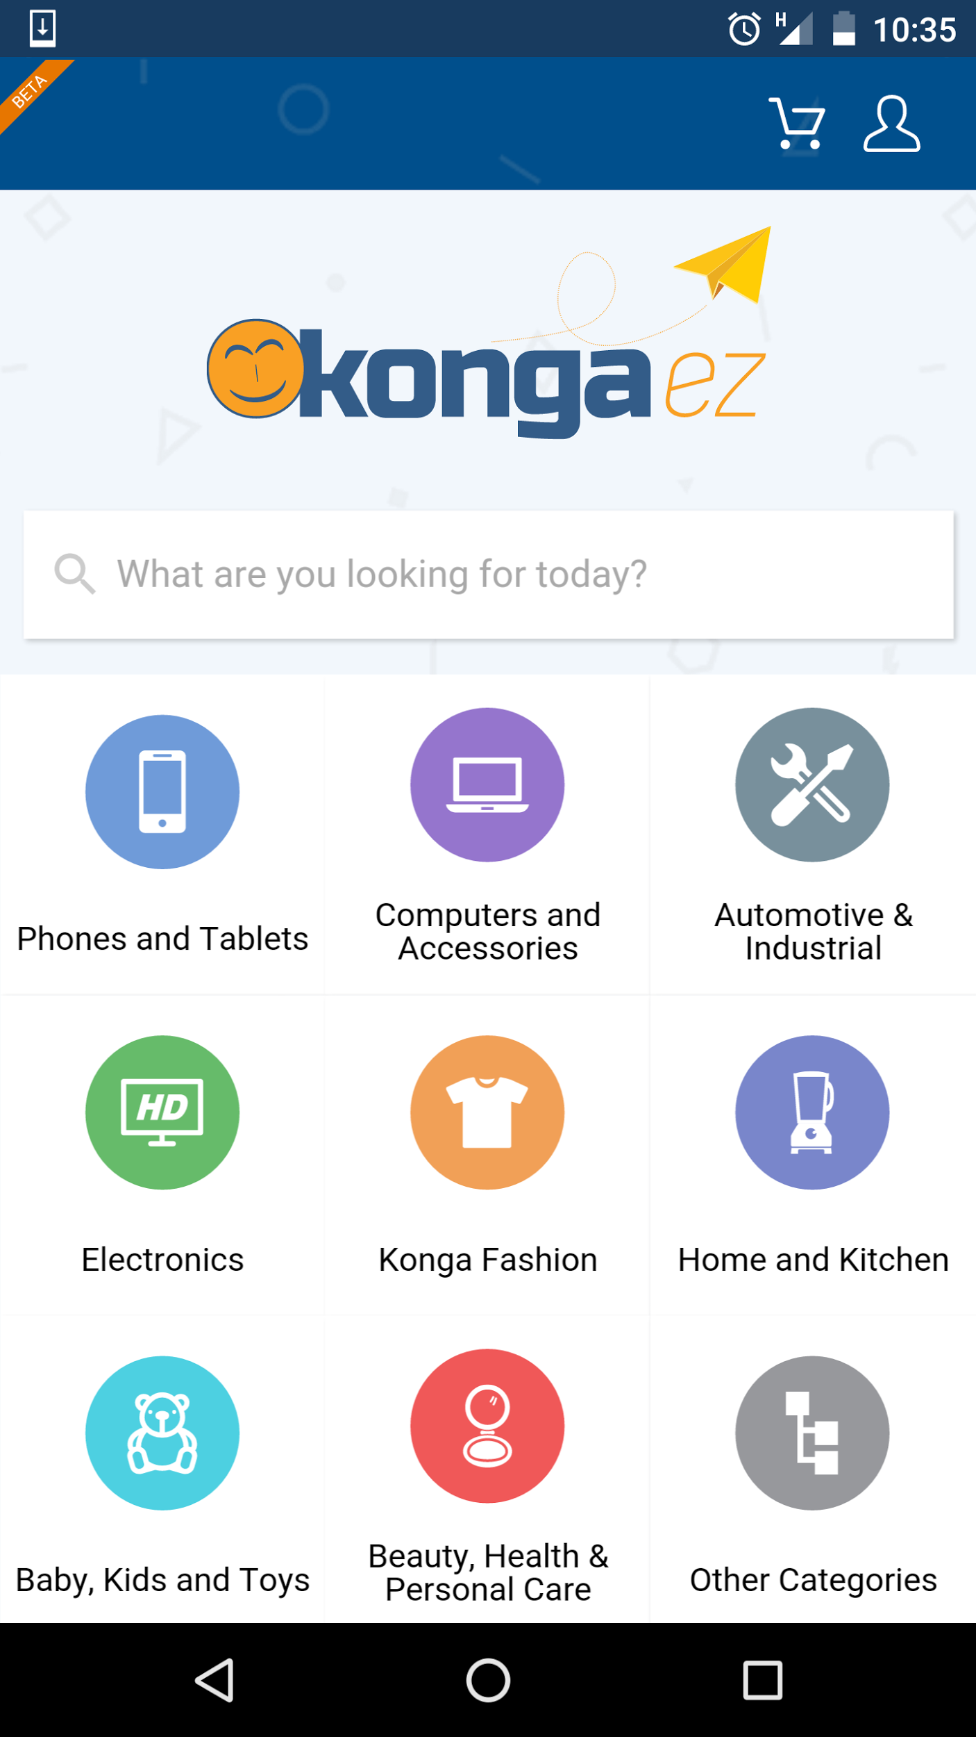
92% less data
for initial load 82% less data
to complete first transaction
Both data points are compared to native app
Notes:
Konga is a major e-commerce player in Nigeria,
They decided to start from scratch calling it ‘Konga EZ’, pronounced ‘easy’.
They had to deliver a full end to end web experience that was as fast, and reliable as their native apps for iOS and Android.
They need their web experience to work offline for catalogue and checkout functionality.
They focused a lot on minimizing data consumption, which is critical for their users. Comparing data usage to their native app, initial load took up 92% less data and data usage to first transaction was 82% less.

Slide 51
Build a simple version
Notes:
Not everyone can take the Konga approach
Starting from scratch is often times not realistic.
Another approach is to build a simple version of site, for example to improve on a specific section or user journey.

Slide 52

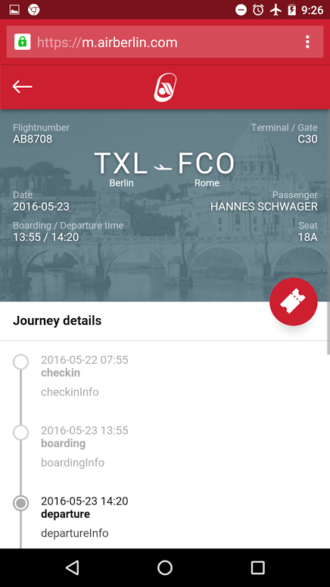
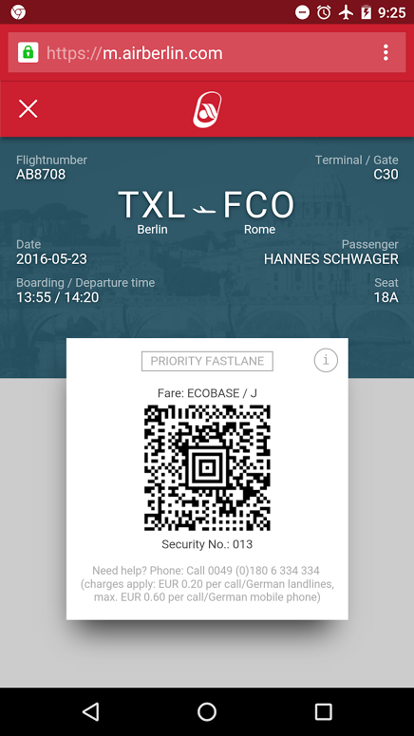
<1s
initial loading time and even faster for sub-sequent loads
Notes:
For Air Berlin, it wasn’t possible to do a site-wide PWA, so they focused on the post-booking experience.
They needed to deliver a fast, engaging reliable experience.
Their users at the airport require quick access to itinerary details, boarding pass and destination information.
They leveraged caching to solve this problem, giving them load times of under a second.
After a passenger has checked in, they can access their journey details and boarding pass — even without internet connectivity.

Slide 53
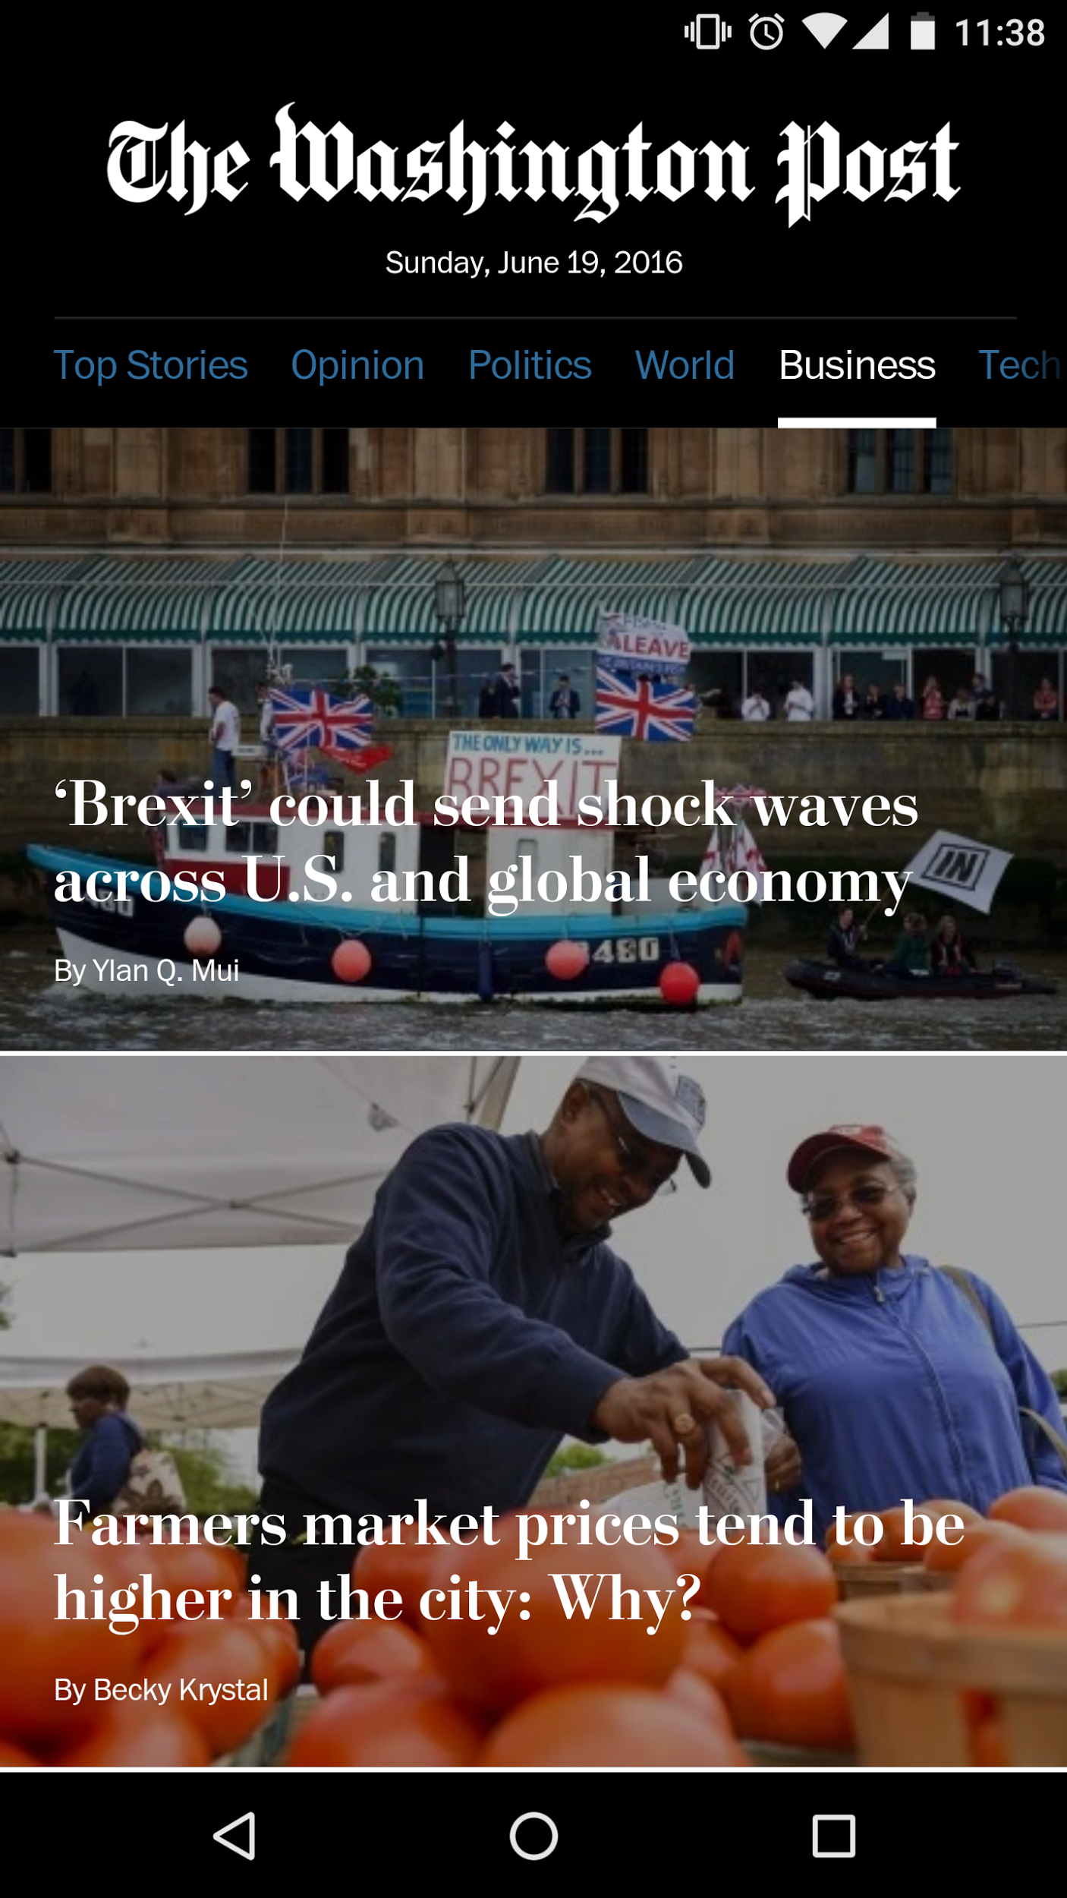

80ms
article page load time in the Progressive Web App
How they did it
Notes:
The Washington Post built a simple version of their site.
They put together a simple Progressive Web App demo using their Top Stories feed.
The goal was to show what type of user experience is possible.
They focused on speed: 80ms page load times with their PWA.
You can see their live public demo at wapo.com/pwa.
Newsroom staff and executives at the Washington Post were really excited to see this new experience.
As a result, they're now actively evolving their demo PWA to it to make it a core mobile web experience.

Slide 54
Focus on a feature
Notes:
Another strategy is to define a specific feature to test.
Pick one thing that you can have high impact.
This is likely to be the case at really large companies.

Slide 55

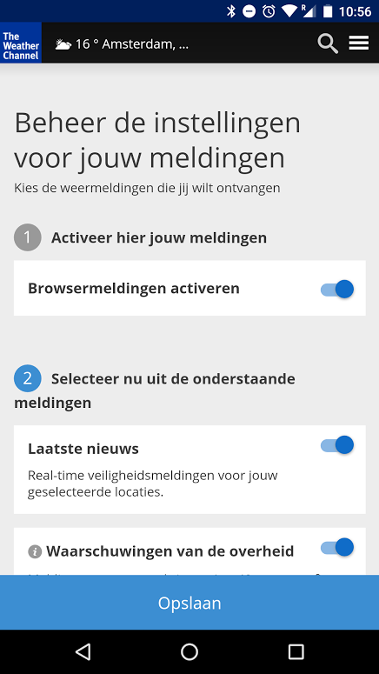
30+ languages
rolled out globally with web push notifications
Notes:
The Weather Channel team has been interested in Progressive Web App technologies for quite some time.
They needed to prioritize based on what they believed would be highest impact for both the user and their business.
They decided to focus on a single feature with Web Push first.
Weather went big with a single feature, rolling out globally in over 30 languages.
Users on their mobile web app can subscribe to multiple types of notifications, just like their native app.
That's how they got started on the journey to building a PWA.

Slide 56

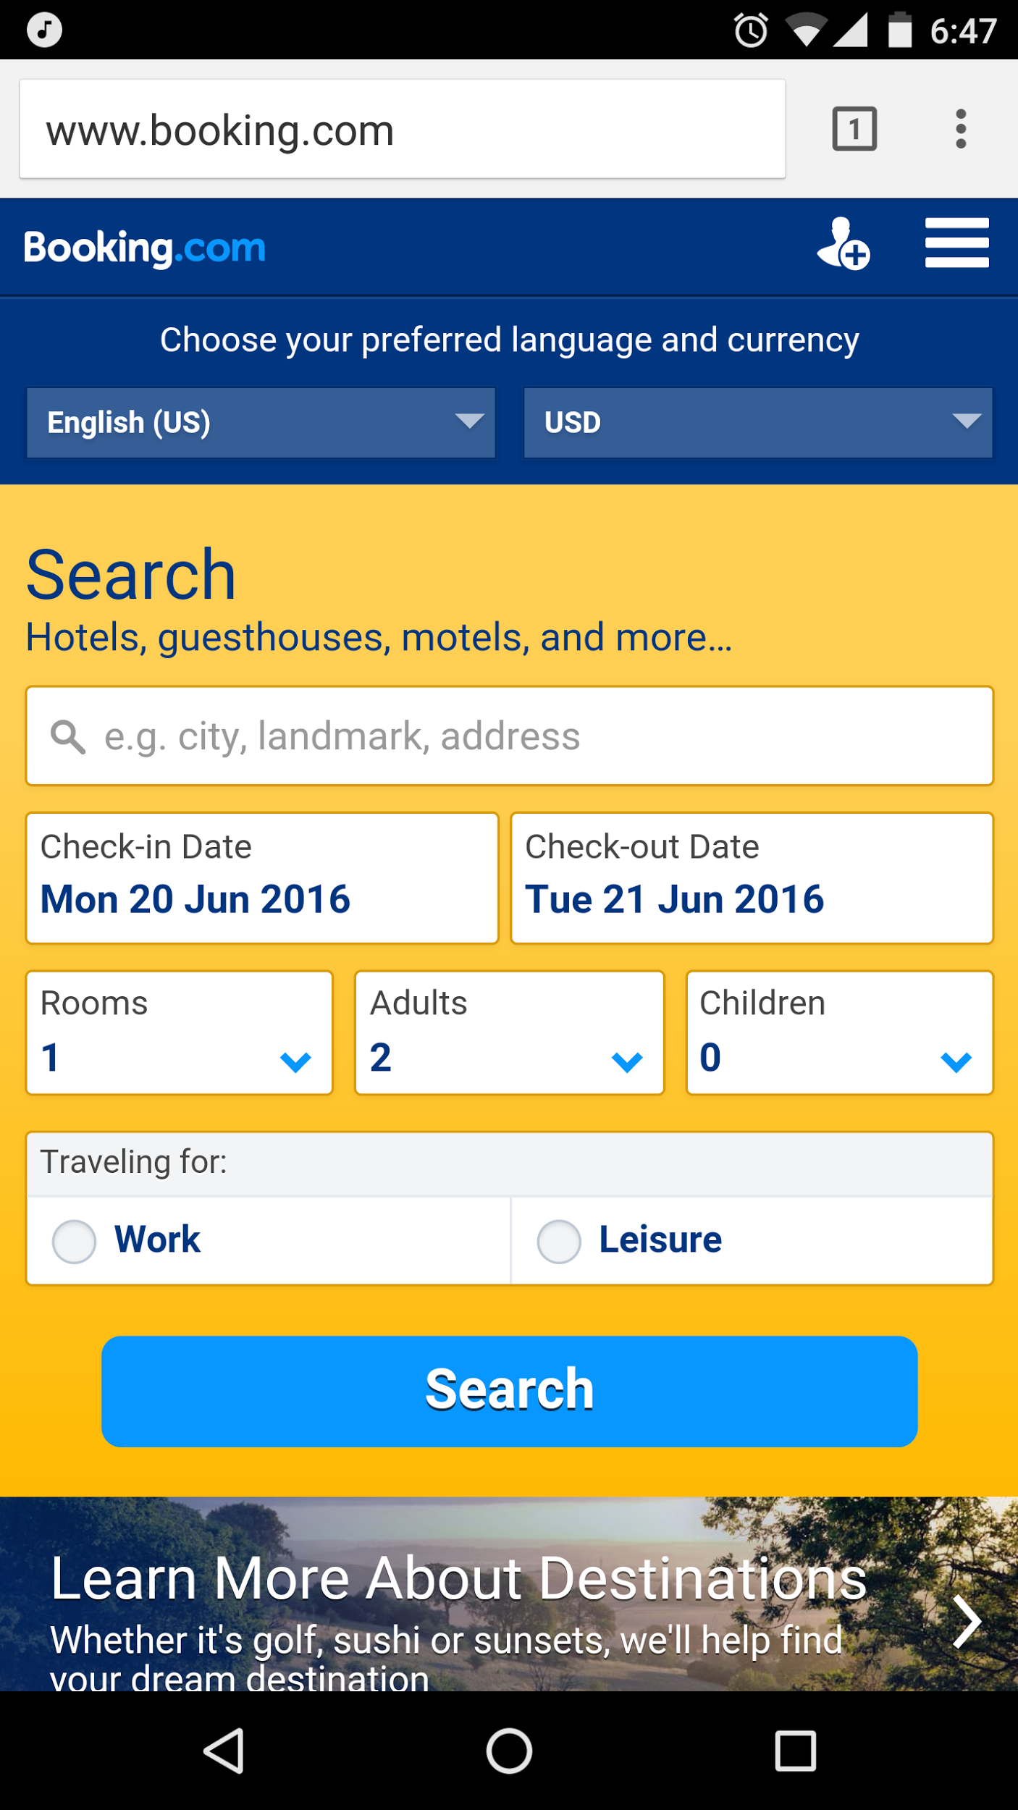
“Even for something as holistic as a Progressive Web App, we work in small steps in order to tackle issues one by one, and learn things quickly.”
Jesse Yang, engineer
Booking Developer Blog Post
Notes:
Booking.com is large travel company.
It's hard for them to make a lot of big changes.
However, they understood importance of Progressive Web Apps.
They're data driven, so it was critical for them to work in small steps to try new features one by one, test them and learn.

Slide 57
from the ground up
a simple version
a single feature
Notes:
So when you think about proposing a path to integrate these technologies, it's helpful to think about these alternative approaches:
Build from the ground up, start with a simple version, or focus on a single feature.
Different paths can make sense for your users and your site.

Slide 58











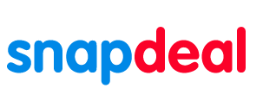




Notes:
We've been so excited to see incredible momentum across the globe
Here's a sample of folks shipping or actively working on PWAs and new web APIs.
With these early adopters we’ve seen that every site has their own way of investing in mobile web and starting down the path toward Progressive Web Apps.

Slide 59

meow
Go build!
Notes:
So now it's your turn!

Slide 60
But first...
Where to start?
Notes:
Well — you need to start with your users.

